Slide 1

 | Department of Computer Engineering S.S.V.P.S’s B. S. Deore Polytechnic, Dhule Academic Year : 2021 – 2022 Second Shift(1100)
A presentation on semester VI Capstone Project Execution
Topic: “Doctor’s Appointment System For Shri Chhatrapati Superspeciality Hospital.”
Presented by |  | 1. Sayyad Alfiya Aasif Ali
 |  | 2. Pansare Dimpal Laxman
 |  | 3. Thakare Tejaswi Ishwar
 |  | 4. Pawar Tejas Pravin
Guided by |  | Mr. Dushyant Potdar
Semester |  | 6 I

Slide 2
Contents
Introduction
Need for the System
Requirement Analysis/User Requirement
Problem Definition
Design Details
Hardware/ software Requirements
Proposed Of The Work
Implementation Details
Conclusion & Future Scope
Refrences

Slide 3
INTRODUCTION
In this modern world, Technology has become replacement of some manually works necessary tools solving problem, as it is arises , everything has been easy for us. That is why in medical field “Doctor Appointment System “ is very significant nowadays .That's why we will choose to develop a system for shri chhatrapati super specialist hospital it is multi specialty hospital includes specialist doctors in this hospital the appointment system is worked the manually the patient can call to receptionist to the hospital to enquire details and they will get the appointment manually after getting appointment patient have to wait too much time till the coming their number we have try to convert it in online mode.

Slide 4
This system design in order for clients to select the appointment time according to her/his preference and for medical staffs to organized their schedules. Since, taking appointment ,manually will take or waste a lot of time that would also possibly risk someone’s life. Thus,” Doctor Appointment system ” is going to be developed to reduce the problem concerning in practicing manual system.
Specality of “ Shri Chhatrapati Hospital ” :
Neuro specialist
Orthopedic
Neuron Surgeon
Plastic Surgeon
General Surgeon
Physiotherapy
Pathology
Radiology

Slide 5
Need For The System
Globally Health care sector is the pivot and integral part of humans lives Thus any error committed in the clinical services might leads to defect or termination of life. recently information and communication has been used extensively and services in the field of the healthcare services. Patient appointment with the Doctor is the one of the clinical services that has been automated. To summarize, an appointment system helps you manage appointments and seamlessly check-in patients to see consultants on arrival. So the online appointment system is very needful to modern world . Always available : Patient can make an appointment 24/7,Easy to use: Nothing to install, no servers or backup to worry about ,Time saving technology , Avoid paper works ,Maintain the contact details of the patient ,Keep track of the appointment dates , Cost effective and easily manageable ,these are all very needful to in this daily life .
Its provide the ability to manage all the paper work in one place ,reducing the work of staff in arranging and analyzing the paperwork of the patient. So these are all benefits in the system .So our system is very needful for the users.

Slide 6
Problem Defination
Doctors are life savers; they shouldn’t be too far from those who need health care. Taking appointment manually will take or waste a lot of time that would also possibly risk someone’s life.
Thus,” Doctors Appointment system” is going to be develop to reduce the problem concerning in practicing manual system. This serves as an easy way to immediate response to the client who badly needs a medical doctor

Slide 7
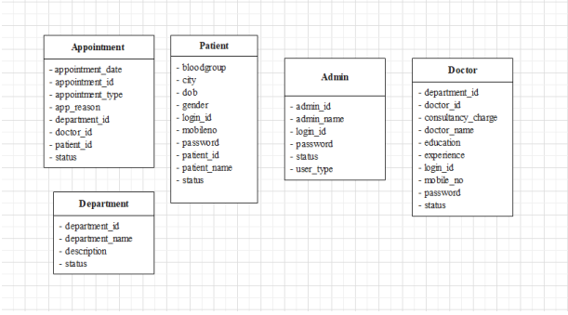
Design Details
Database Design

Slide 8
Module details
Patient’s Account
After making an appointment for the very first time, the user can log in to the system and check their appointment status. By default, each appointment is set to pending status. Also, the patient can remove their appointments anytime.
Doctor’s Panel
Each doctor will have their own personal account for the doctor will see his appointment only on his profile. which lets them access the system. After approving the appointment, the doctor can view the patient’s profile and appointment record.
Admin Panel
On the other hand, the admin has full control over the system. He/she can view all the existing records of the hospital. An admin can manage patients, doctors, their departments. An admin has the right to register a doctor’s account. The admin can view all the appointment records too.

Slide 9
Hardware and Software requirements
Hardware Requirements:
RAM- 4GB
Processor – intel i3 7th Gen.
Hard Disk Drive/Solid State Drive – 100GB
Software Requirements:
Browser
XAMPP Server
Sublime

Slide 10
Requirement analysis /User requirement
The system has three users .Admin, Doctor, and Patients. So all features has been divided between this three users.
The User describe some of the basic requirements or the system this includes search for patient, register patient , Update record , Doctor information record , view doctor .
Admin can add Doctors and patient .
After making an appointment for the very first time, the user can log in to the system and check their appointment status. By default, each appointment is set to pending status.
The patient can remove their appointments anytime.
Each doctor will have their own personal account which lets them access the system.

Slide 11
Each doctor will have their own personal account for the doctor will see his appointment only on his profile.
An admin can manage patients, doctors, their departments. An admin has the right to register a doctor’s account.
The admin can view all the appointment records too.

Slide 12
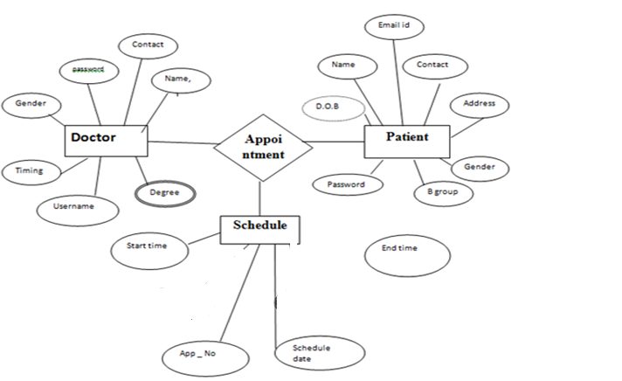
E-R Diagram

Slide 13
Modules
Receptionist
Users
Patient
Doctor

Slide 14
Proposed of the work
The proposed of the project is a smart appointment system that provided patients or ,may user an easy way of booking a Doctor’s appointment online
This is a website that overcomes the issue of managing and booking appointment according to user choice or demand .
The purposed of the project is to build an Application program to reduce the manual work for managing the Doctor, patient, Appointment.
Allows patient to book an appointment from the comfort of their home using their computer, laptop or mobile , and at any time , no matter where they are ,they can contact doctors of their choice in any location.
The patient can request for an appointment on his /her preferred day or time The selected day or time slot will be reserve and the patient will successfully book their appointment .

Slide 15
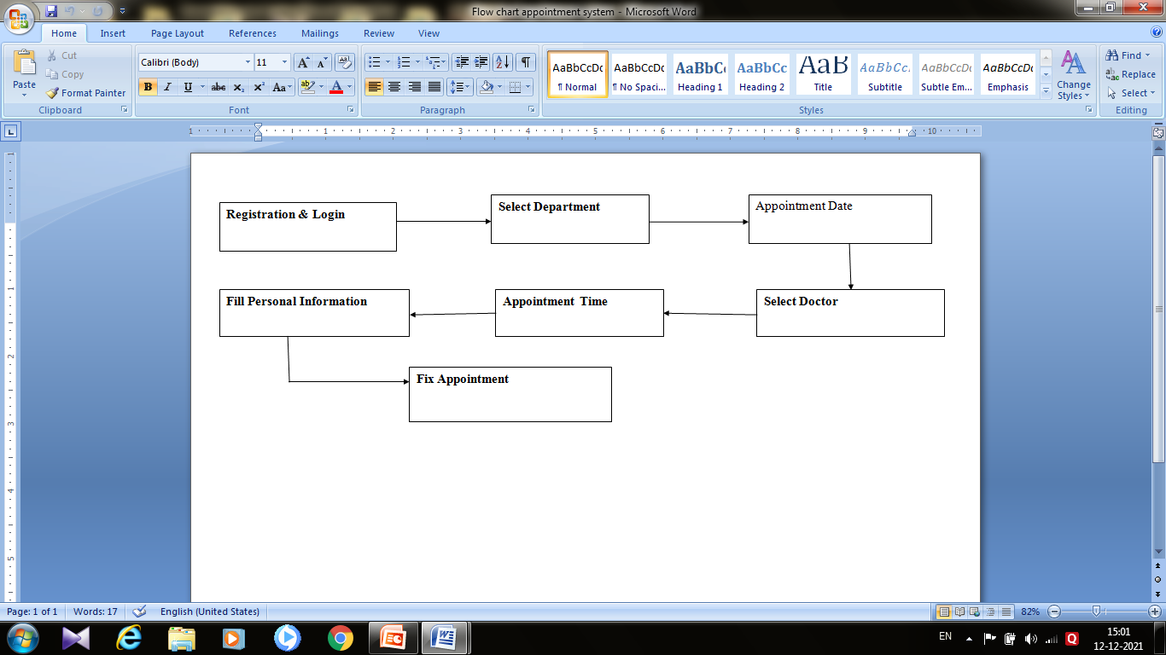
The aim of proposed system is to develop a system of improve facilities the proposed system can overcome all the limitation of existing system the system provide proper security and reduces the manual work .

Slide 16
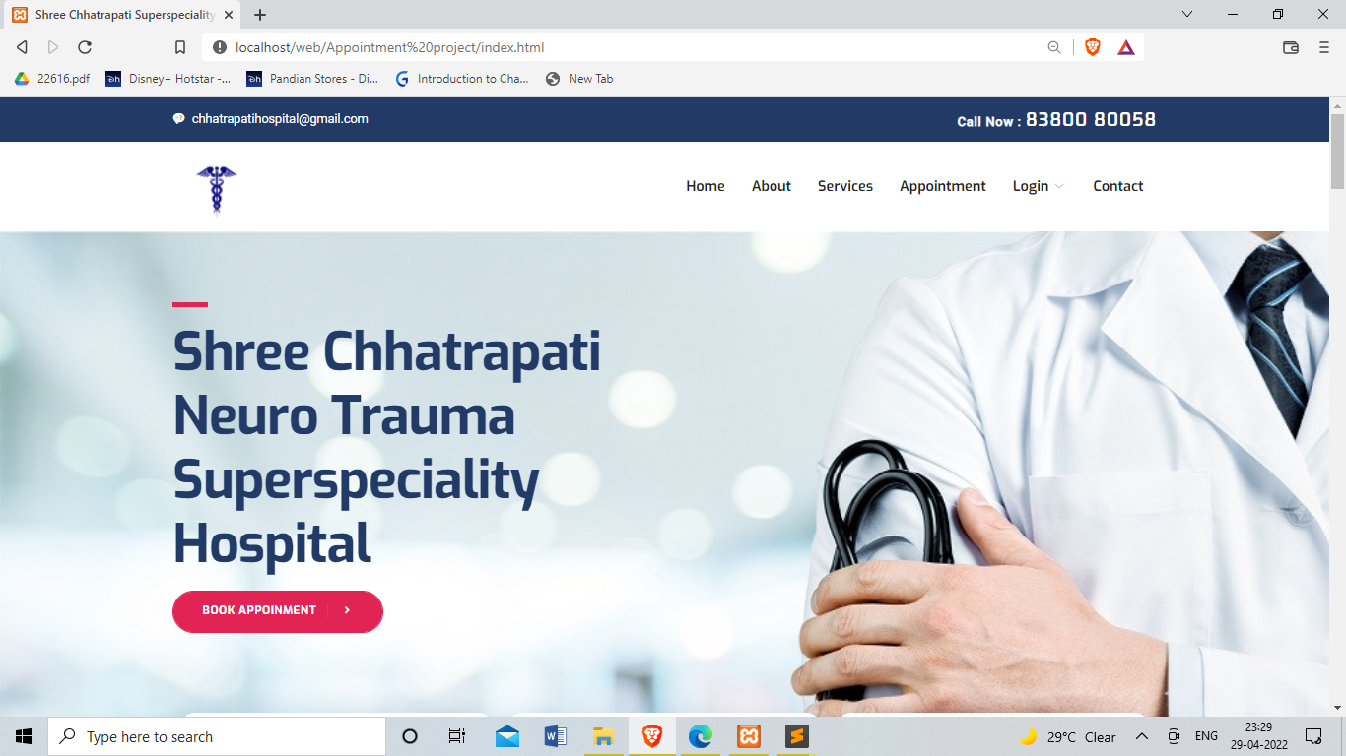
Implementation Details

Slide 17
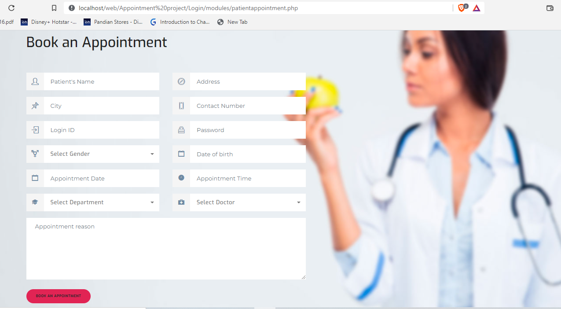

Slide 18
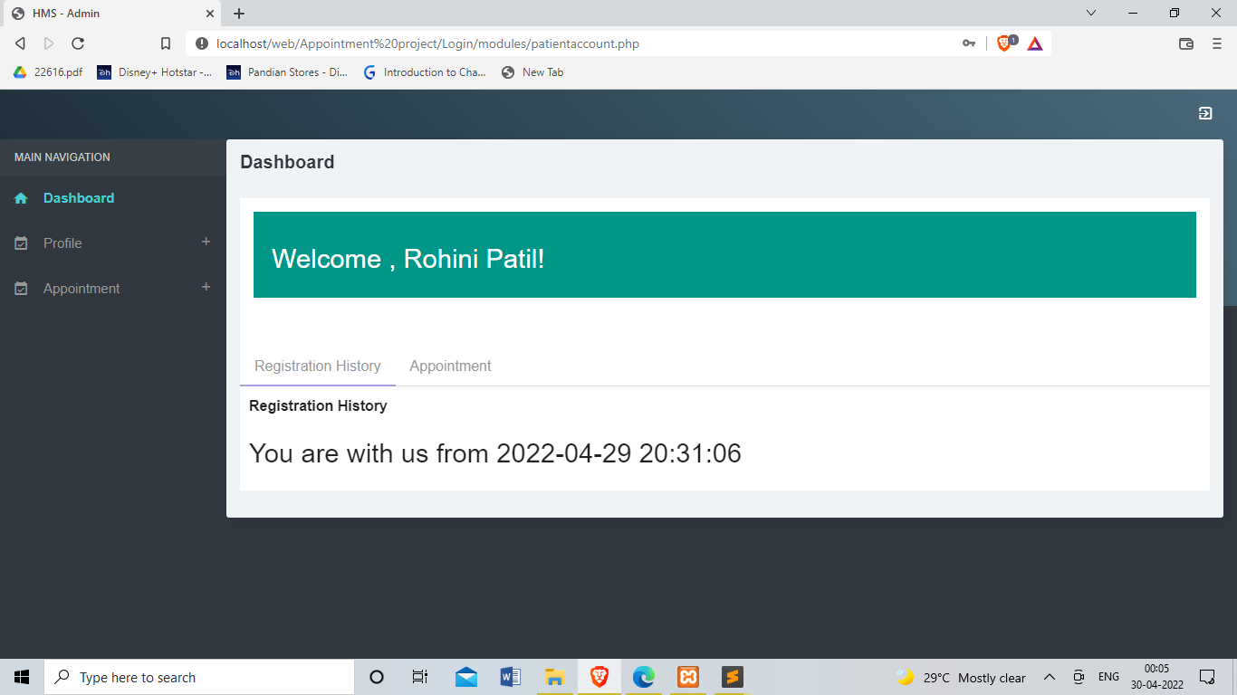

Slide 19
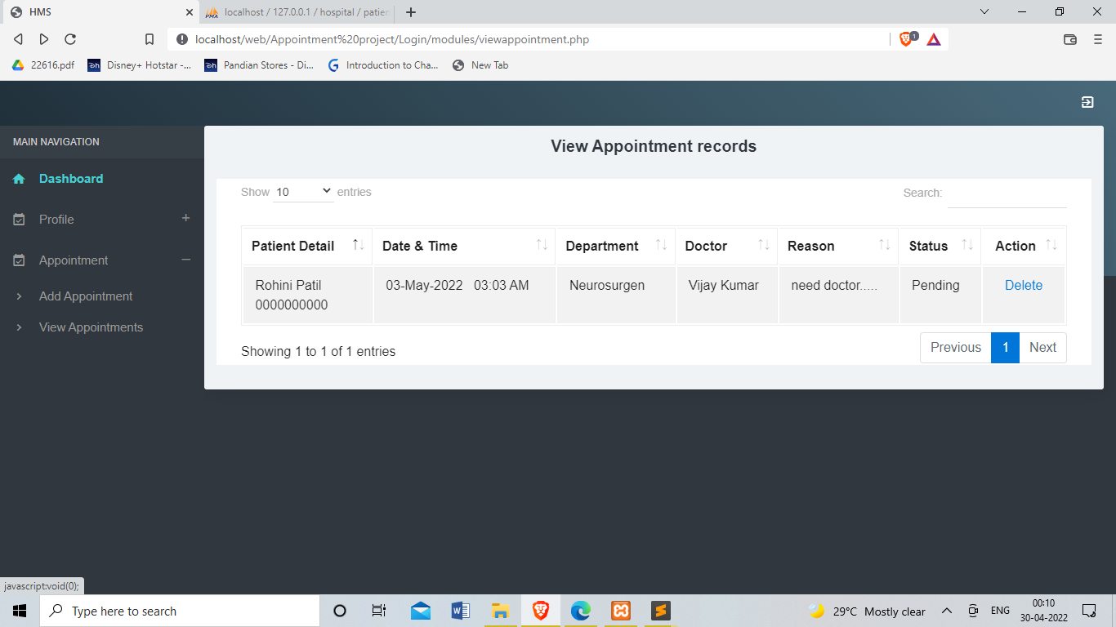

Slide 20
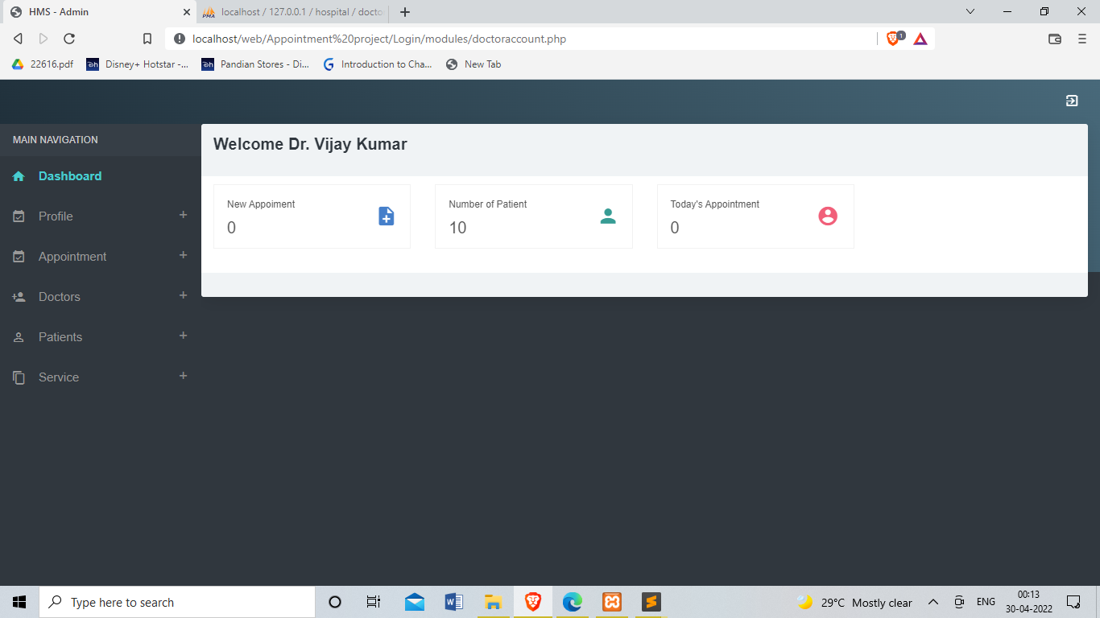

Slide 21
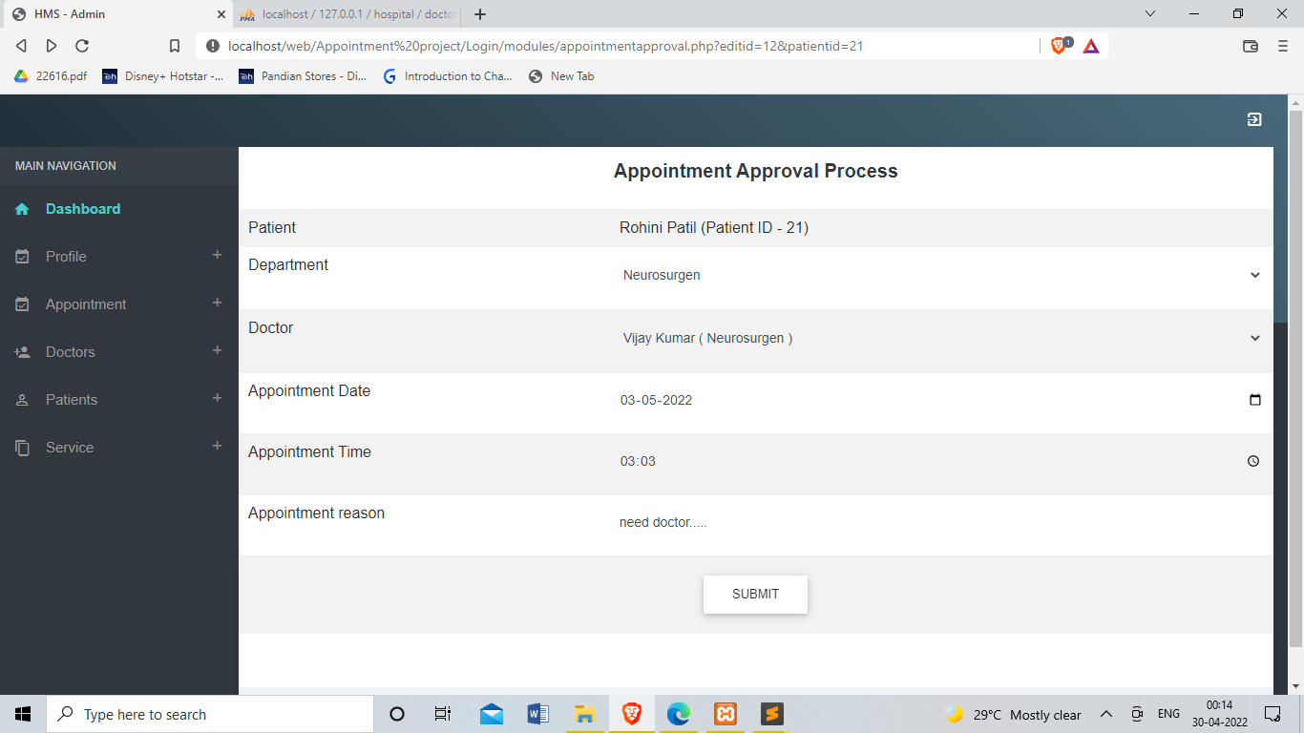

Slide 22
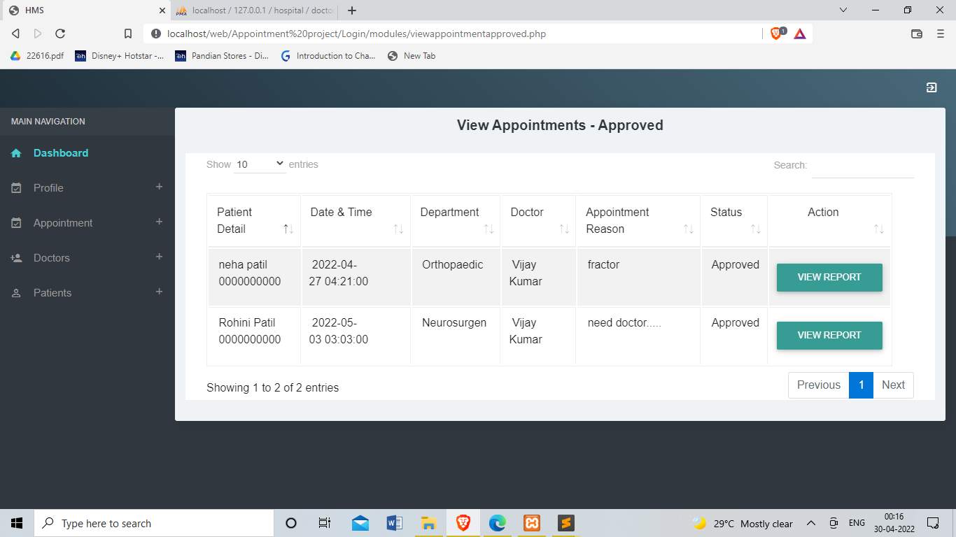

Slide 23
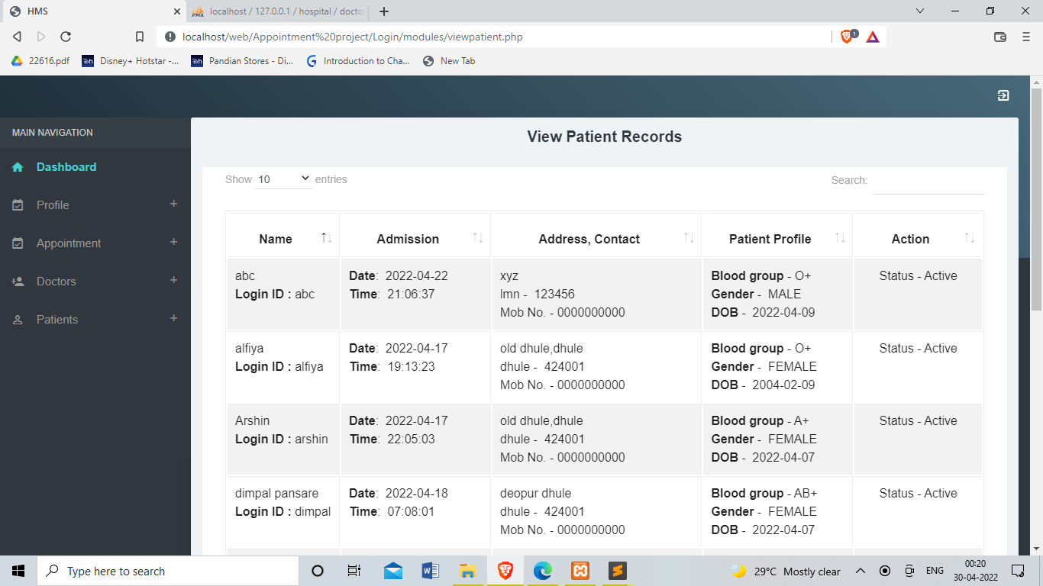

Slide 24
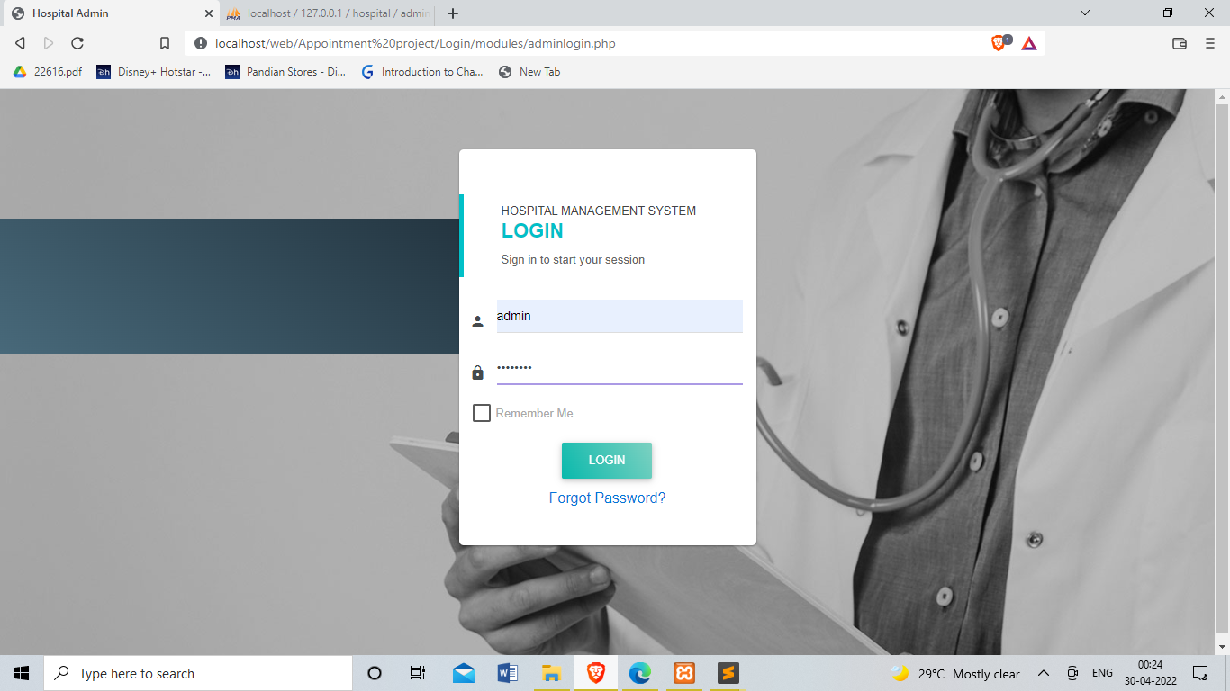

Slide 25
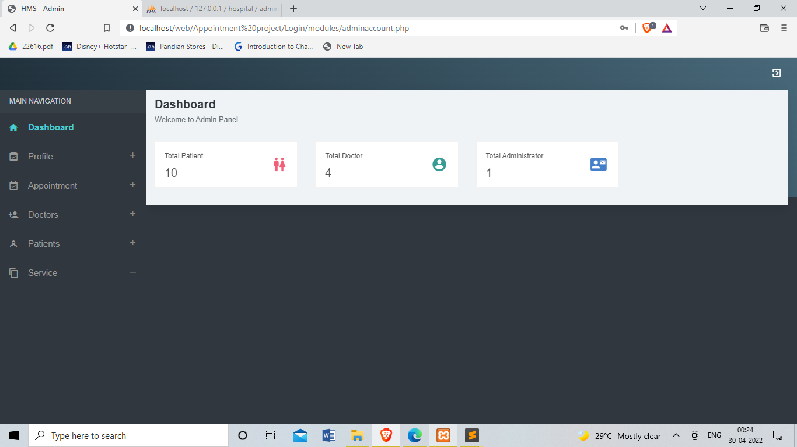

Slide 26
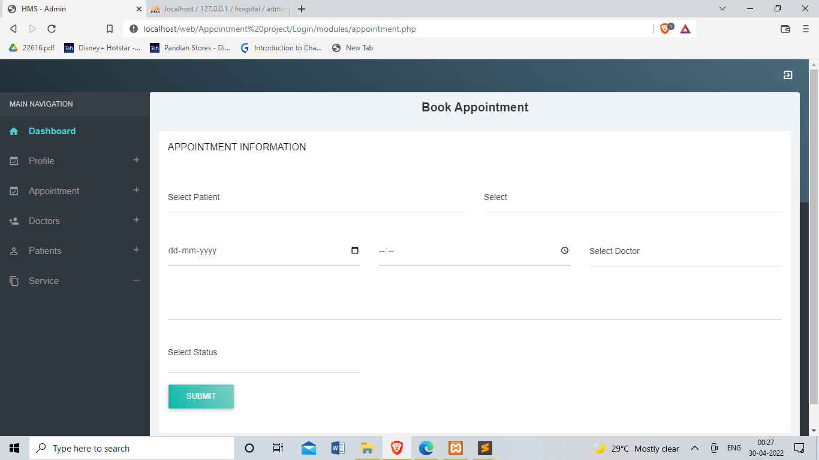

Slide 27
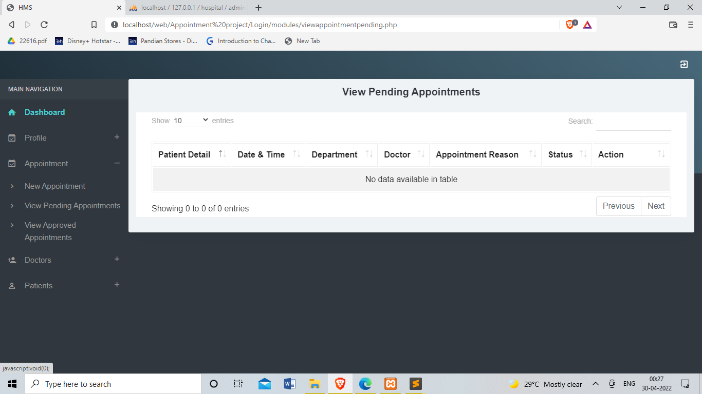

Slide 28


Slide 29
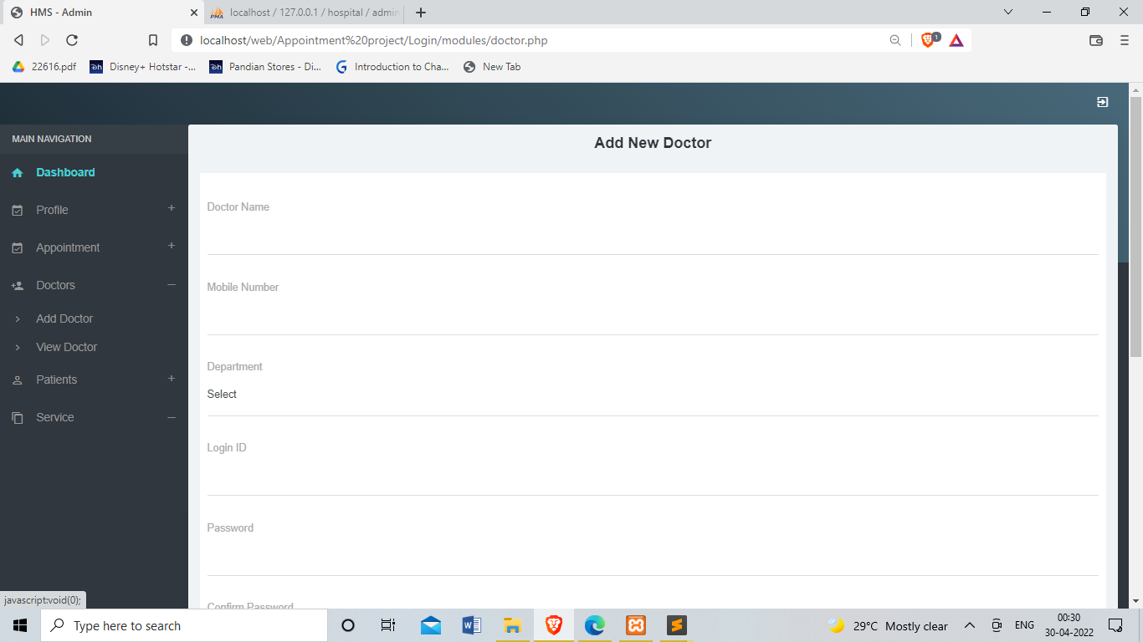

Slide 30
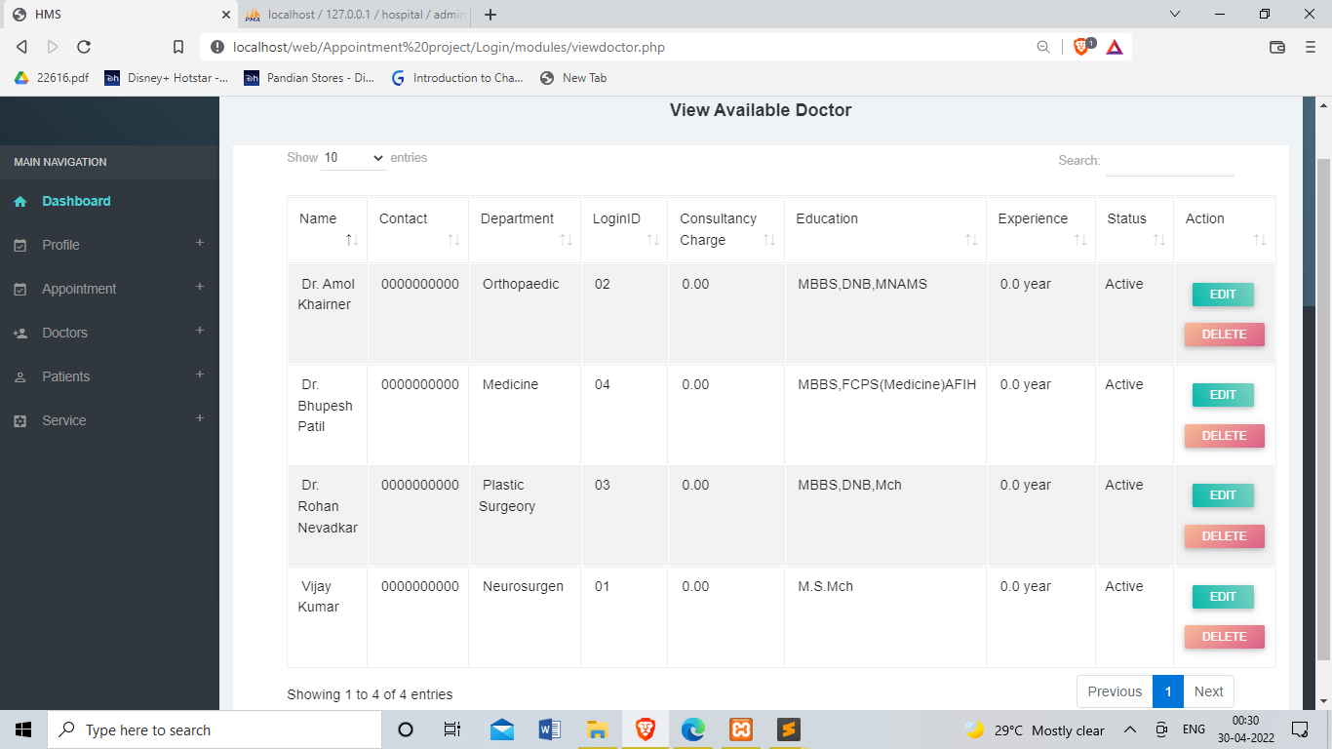

Slide 31
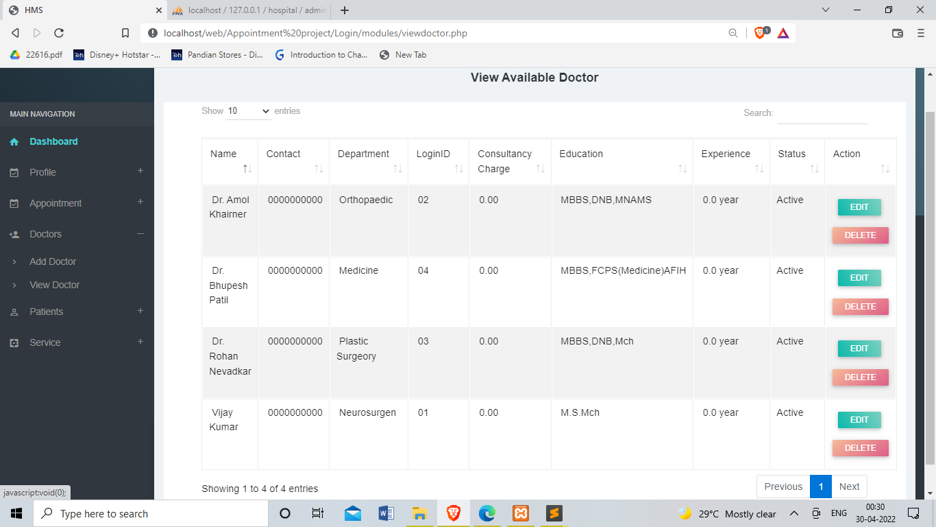

Slide 32
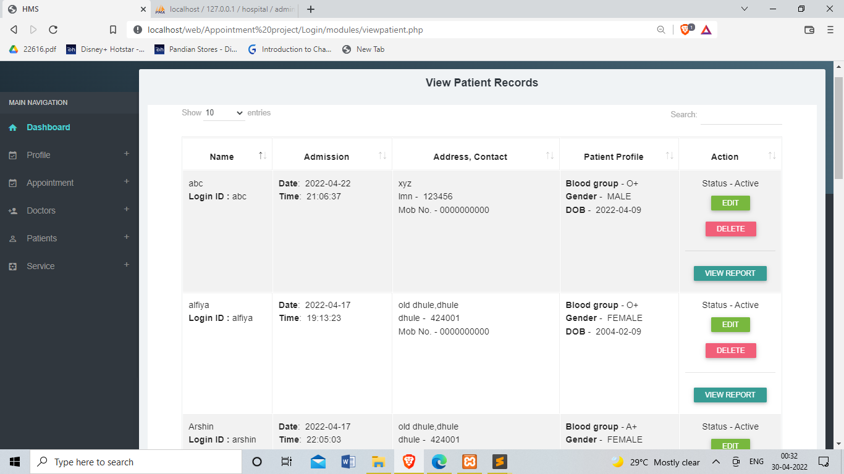

Slide 33
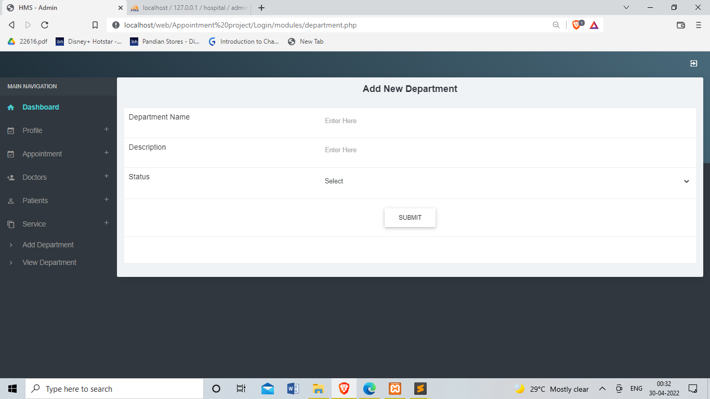

Slide 34
Conclusion &Future Scope
Conclusion
Compare to the usual appointment method, the web-based appointment system could significantly increase patients satisfaction with registration and reduce total waiting time effectively. However further improvements are needed for broad use of the system. Web-Based appointment system, registration, waiting time, patient satisfaction with getting a registration and reduce waiting times. A lack information about online appointment was the main reason for not using the system .To increase the efficiency of the registration system to reduce non attendance rates, further studies on various interventions such as the promotion of online registration.

Slide 35
Future Scope:-
In system we can changes in future like we make it as a message reminder appointment system.
Increase retrieve- ability and data security.
Enhance efficiency and patient carte.
We also changes in the system like medication nd health care for easy tom patient have know all things through website .

Slide 36
References
Research Paper :-
Quaffas, Alaa and barker, trevor, ”Online Appointment management System”,2012
Websites :-
https://www.curemantra.com/blog/why-patients-want-online-appointment-bookingsystem/
https://www.inettutor.com/source-code/doctor-appointment-system-capstone-projectproposal/

